Slide 1

Employee Onboarding System
Presented By
Jakker Noor
Simhadri Patapanthula
~ JNN INSTITUTE OF ENGINEERING

Slide 2
Table Of Content
What Is Employee Onboarding
Project Overview
Proposed Statement
Optimizing Employee Onboarding
Data Report for Management Team
Technology Used
Meet Our Team
Summary

Slide 3
Mechanism through which new employees acquire the necessary knowledge, skills, behaviors, and relationships to become effective organizational members and insiders
What Is Employee Onboarding

Slide 4

Project Overview
Our Employee Onboarding System is designed to revolutionize the way we welcome and integrate new team members
Here's why it's crucial :
Smooth Transitions
Enhanced Engagement
Improved Organizational Performance

Slide 5
Proposed Statement
Objective
Our project facilitates the seamless transfer of new employee data to the management team, ensuring efficient communication and information flow within the organization.
Personal information, job role, and contact details are captured during new employee onboarding
The captured data is securely transmitted to the management team
These actions enhance the onboarding experience by ensuring that new employees receive support and resources promptly, facilitating a smooth transition into their roles

Slide 6
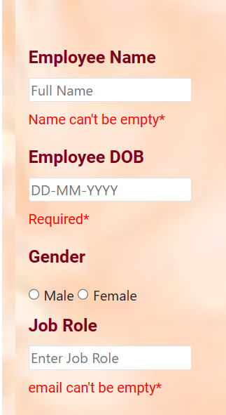
Optimizing Employee Onboarding
Ensuring Completeness of Employee Data
Required Fields Highlight Mandatory Information
Reduced Errors by Preventing Missing Data
Enhancing Onboarding Experience for New Employees

Slide 7
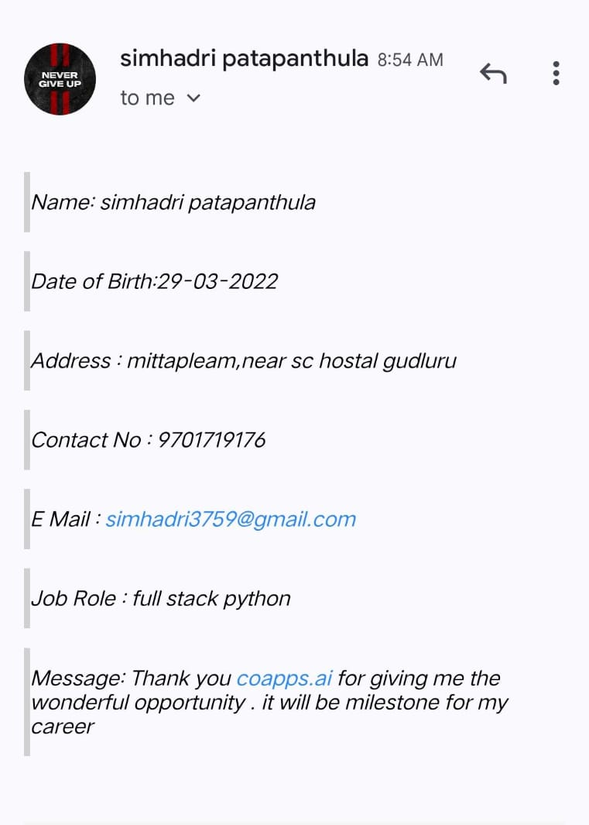
Data Report for Management Team
Upon onboarding, new employee data entered into the website is efficiently relayed to the management team via email, facilitating prompt access to essential information. This streamlined process promotes effective communication and informed decision-making throughout the onboarding journey..

Slide 8

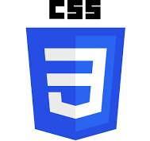

Technology Used
HTML(Hyper Text Markup Language)
HTML is a foundational language used for structuring and presenting content on the web, employing tags to define elements such as headings, paragraphs, links, and images.
CSS(Cascading Style Sheets)
CSS is a styling language used to control the presentation and layout of HTML documents, allowing designers to specify aspects like colors, fonts, spacing, and positioning to enhance the visual appearance of web pages.
JS(Java Script)
JavaScript (is a versatile programming language primarily used for adding interactivity and functionality to web pages, enabling developers to create dynamic content, handle user interactions, and manipulate HTML elements in real-time.

Slide 9


Meet Our Team
Jakker Noor
ECE
Simhadri Patapanthula
ECE

Slide 10


Summary
Our Employee Onboarding System is designed to revolutionize the way we welcome and integrate new team members. With a focus on efficiency, effectiveness, and employee experience, our project aims to streamline the onboarding process and enhance organizational performance.”

Slide 11




Thank you
Jakker Noor
jakeernoor742@gmail.com
Simhadri Patapanthula
simhadri3759@gmail.com

